Slide 1
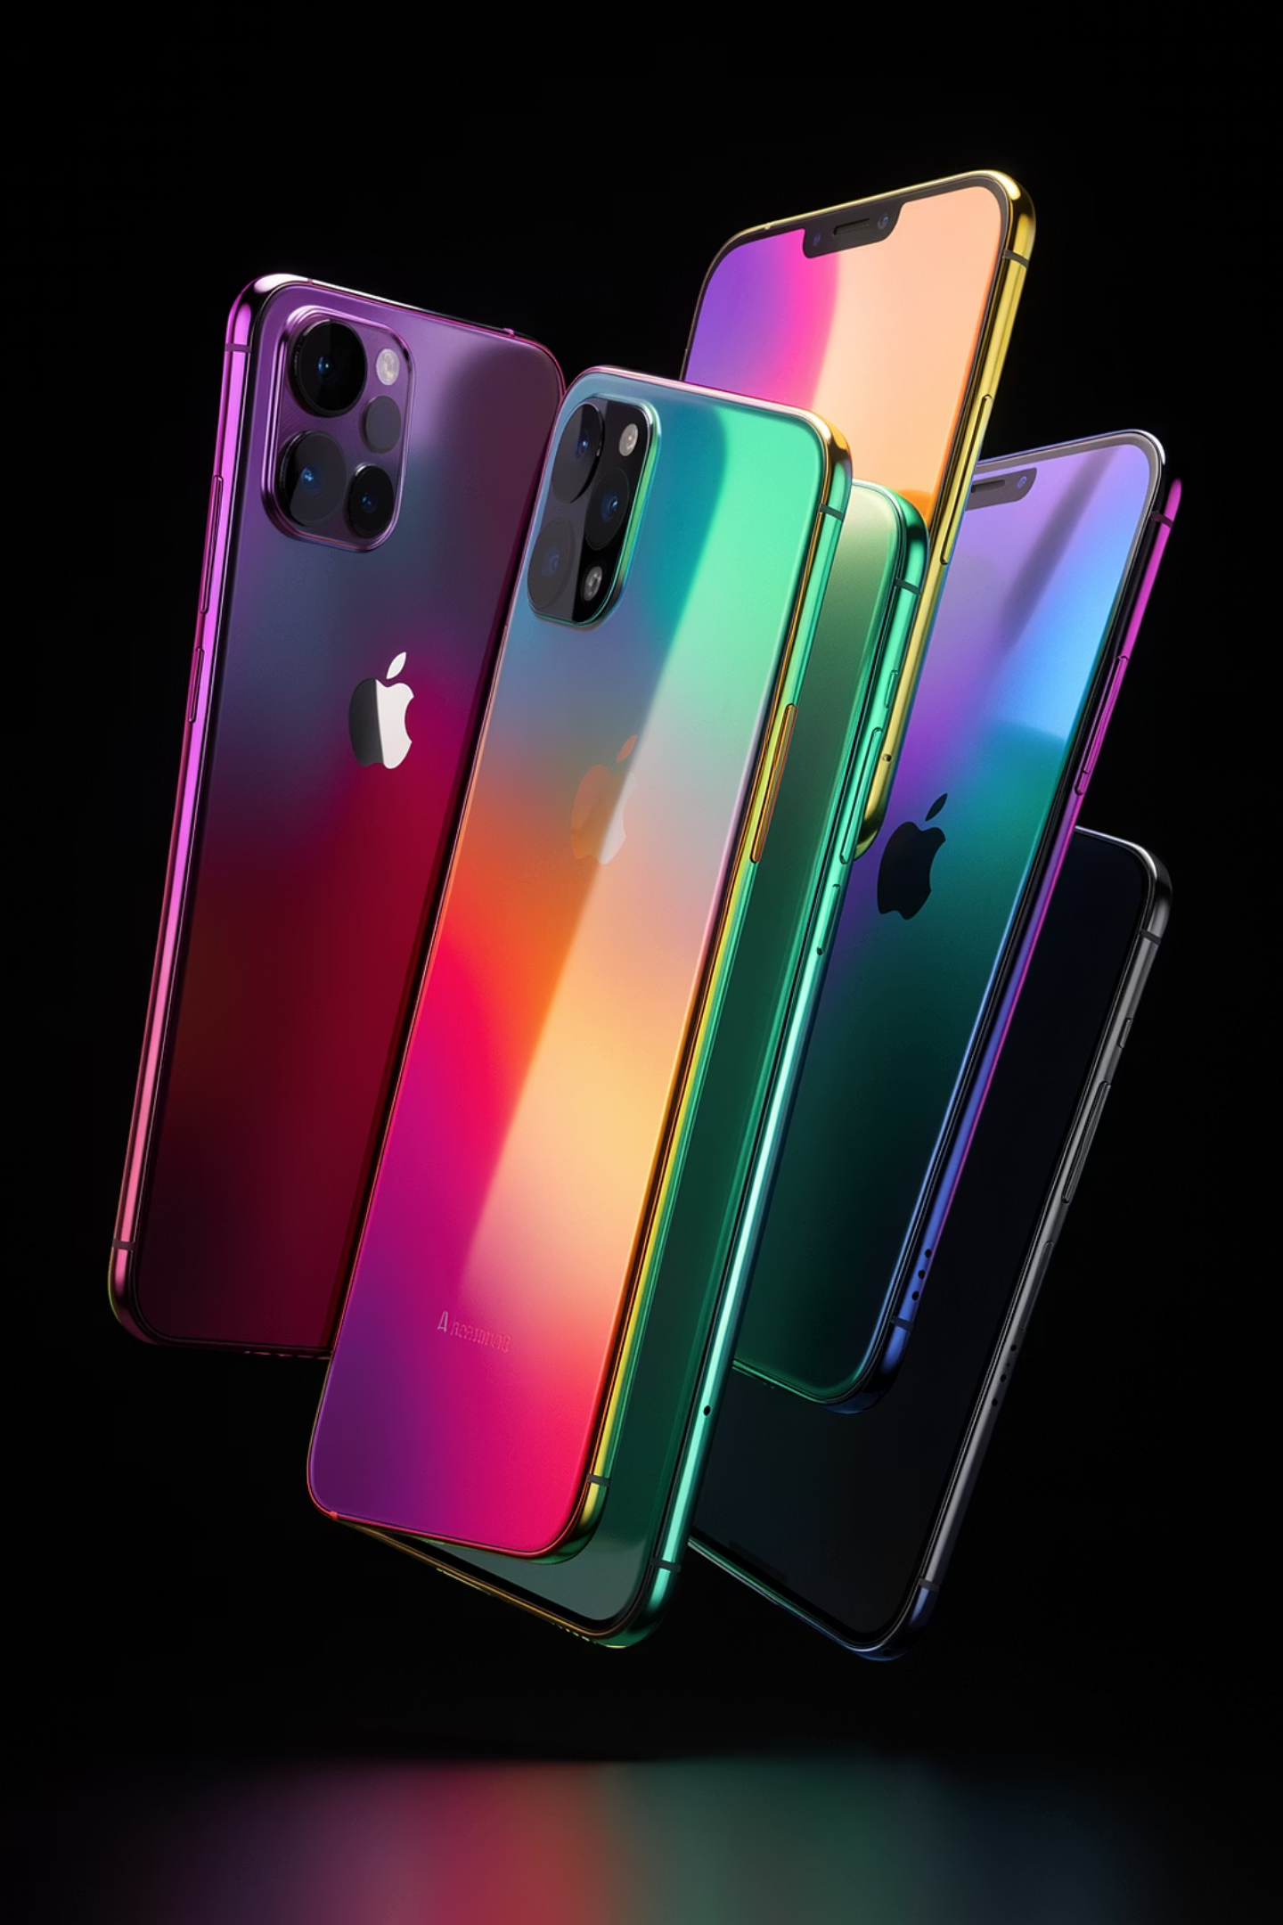
Mobile Price Prediction
Unlocking Value with Machine Learning
Presented by Rajvir Kaur & Navneet Kaur ·
Registration No. 72512125 & 72513252

Slide 2
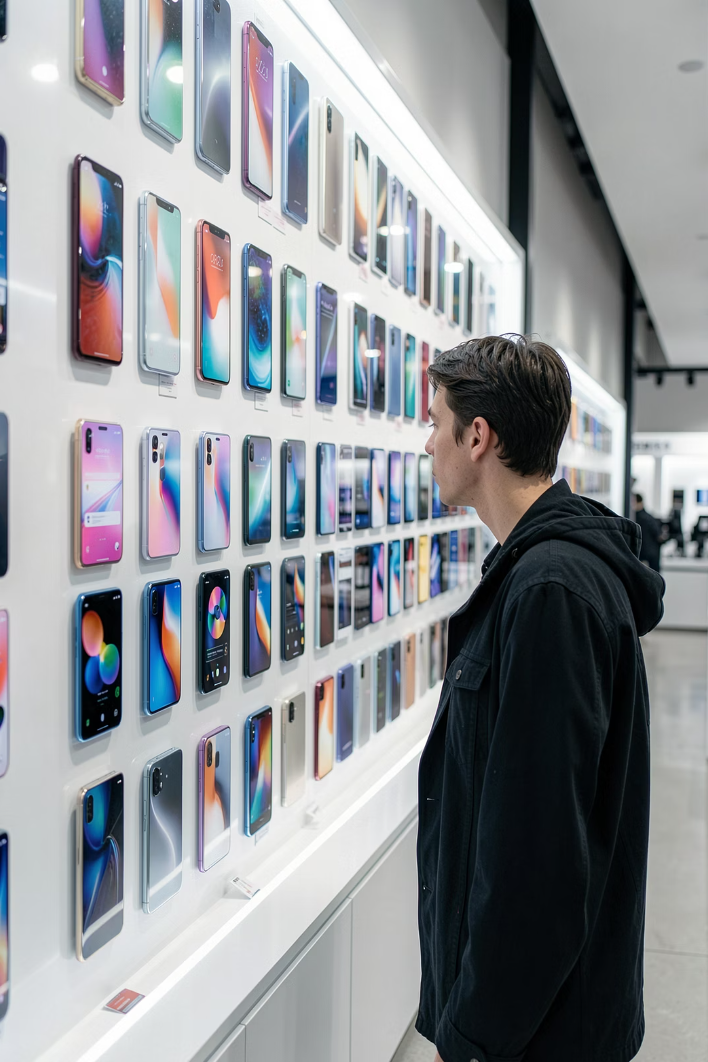
The Challenge: Navigating the Smartphone Jungle
😵 Overwhelmed by Choice
⚖️ Feature vs. Price
How do RAM, camera quality, and battery life actually influence cost? The relationship isn't always obvious.
Thousands of models flood the market every year. Finding the right phone is confusing and time-consuming.
📊 The Need for Insight
Both consumers and manufacturers need data-driven tools to understand and predict fair market value.

Slide 3


Our Solution: Machine Learning for Price Prediction
What Data We Use
Our model analyzes 1,000+ smartphones using these key features:
RAM & Internal Storage
Processor Speed & Core Count
Front & Rear Camera Resolution
Screen Size & Display Quality
Battery Power & Talk Time
Connectivity: 4G, 3G, Bluetooth, Wi-Fi
We use XGBoost and Random Forest regression algorithms to detect pricing patterns from real-world data.

Slide 4
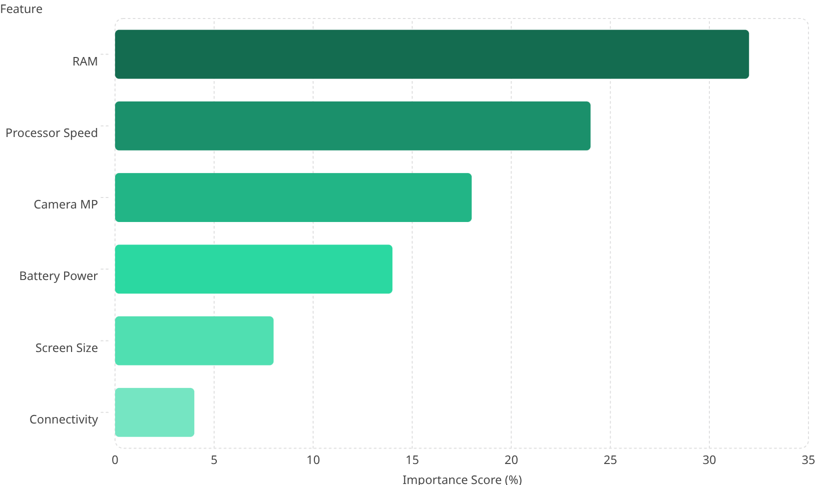
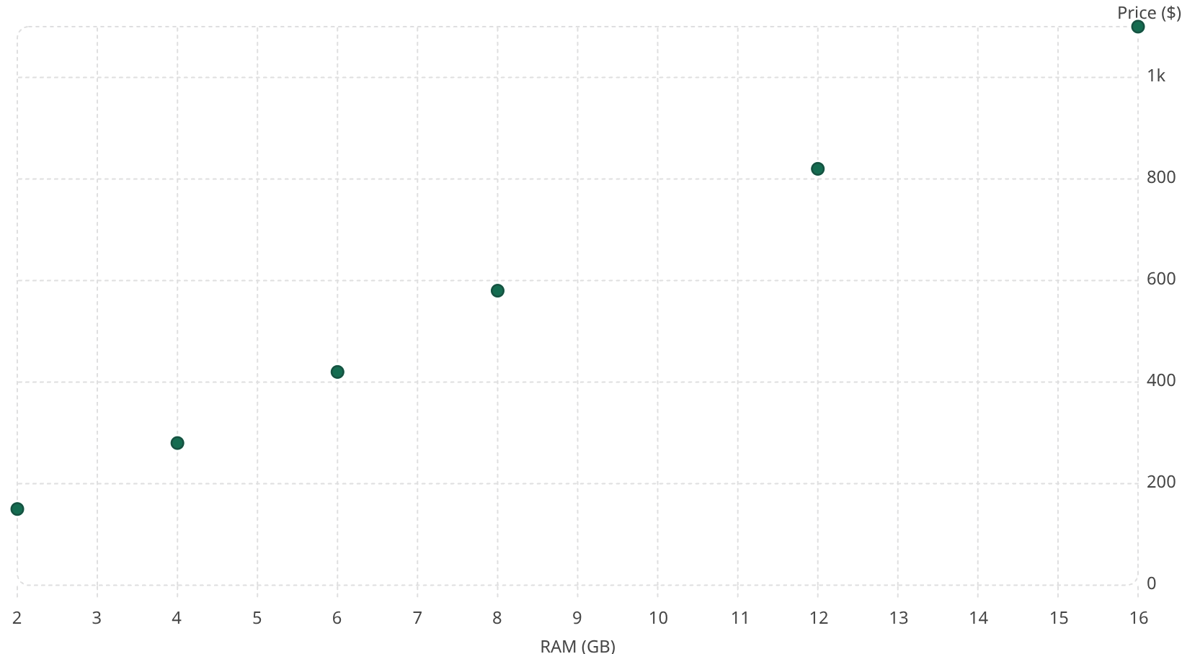
Visualizing the Data: What Drives Price?
Price ($)
Observation: Higher RAM consistently correlates with higher prices — a strong linear signal for our model.
Key Insight: RAM, processor speed, and camera megapixels are the top three price predictors.

Slide 5


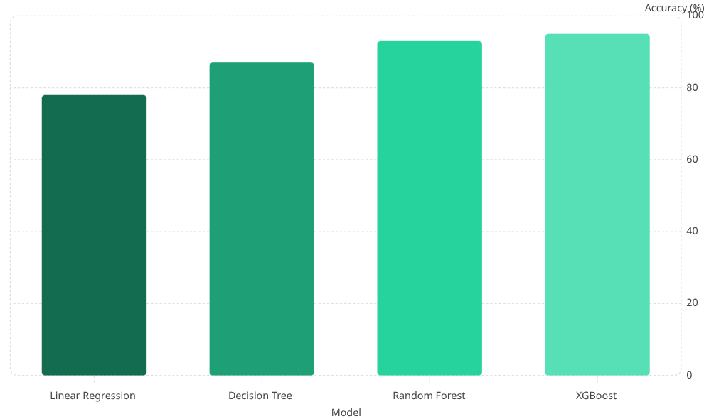

Building the Prediction Model
Data Preprocessing
Prediction Output
Clean and format raw smartphone data
Instant price estimate with 95% accuracy
Model Training
XGBoost and Random Forest learn patterns
The model goes through a clean three-stage pipeline — from raw data to a trained algorithm to an instant, accurate price prediction.
Model Performance
XGBoost achieved the highest accuracy at ~95%, making it our best-performing model. Predicted prices closely match actual market values.

Slide 6
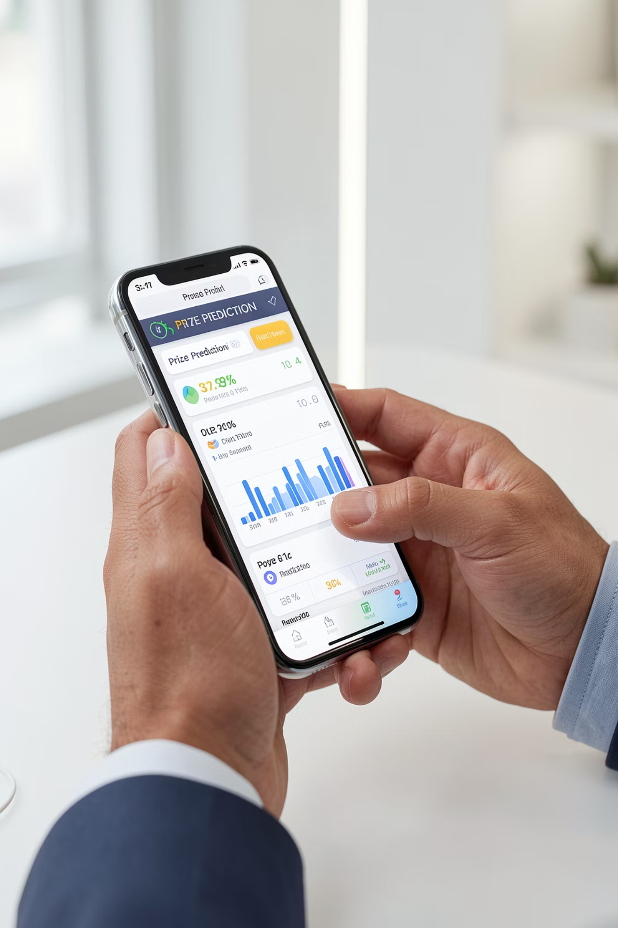
How It Works: A User's Perspective
Input Your Specs
Users enter desired features — RAM, camera, battery, and more — into a simple web interface.
Real-Time Prediction
The trained ML model instantly processes inputs and estimates a fair price range in milliseconds.
Empowered Decision
Users compare options, stay within budget, and choose a phone that truly matches their needs.

Slide 7


Impact & The Road Ahead
Who Benefits?
This tool creates value for both sides of the market — helping buyers make smarter choices and helping brands price competitively.
Future Enhancements
Integrate real-time market data and broader datasets
Explore deep learning for more nuanced predictions
Predict resale value and device longevity over time

Slide 8


Thank You
Thank you for your attention. I welcome your questions and feedback.
Presented By
Rajvir Kaur & Navneet Kaur
Registration Number
72512125 & 72513252
Topic
Mobile Price Prediction using Machine Learning
Questions are welcome! 🙋

